Slide 1

MATALE PETER MOLEPO (PROJECT 2)
OASIS INFOBYTE

Slide 2

Project Description
This data analytics project will examine consumer behaviour and purchase patterns for an e-commerce company, allowing for more focused marketing techniques, increased customer happiness, and superior business strategies.

Slide 3
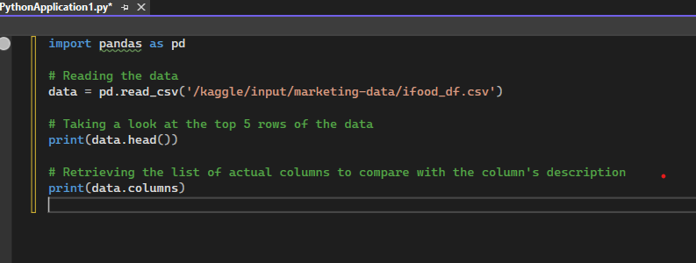
Step 1: Entails evaluating the data columns and comparing them to the dataset description.

Slide 4
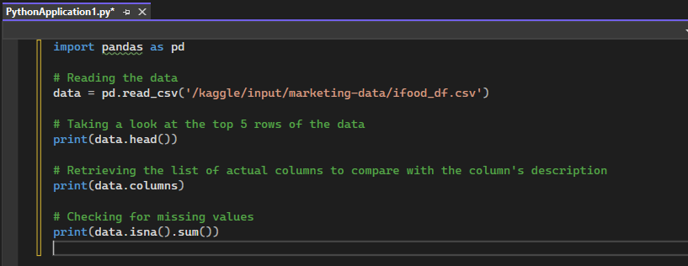
Step 2: Look for Missing Values

Slide 5
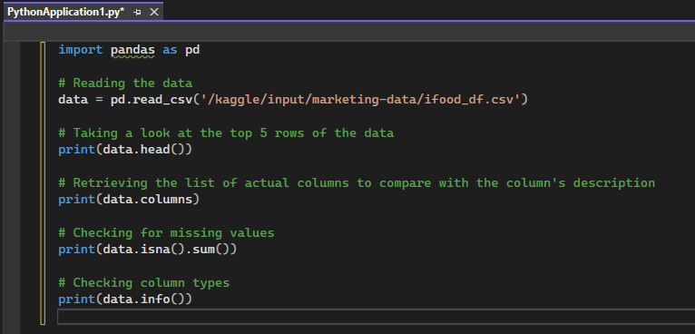
Step 3: Check Column Types

Slide 6
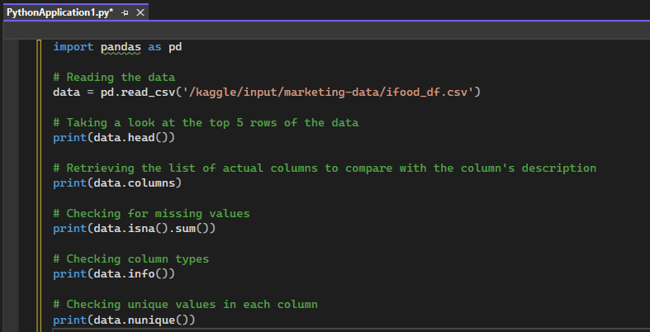
Step 4: Assess Unique Values

Slide 7
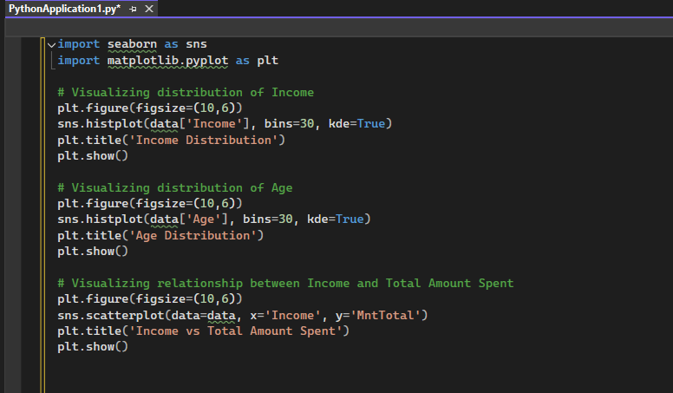
Exploratory Data Analysis (EDA)

Slide 8
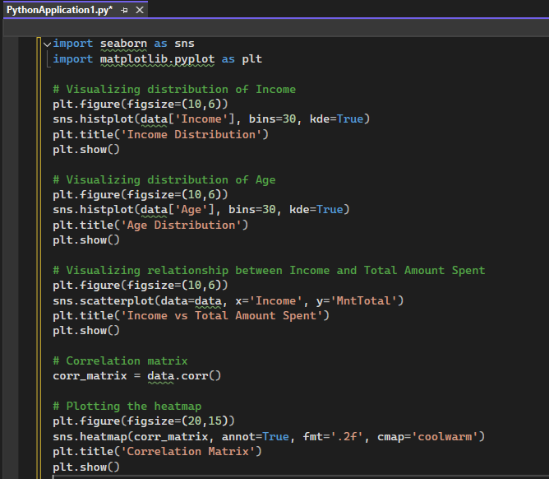
Correlation Analysis
Understanding relationships between variables.

Slide 9
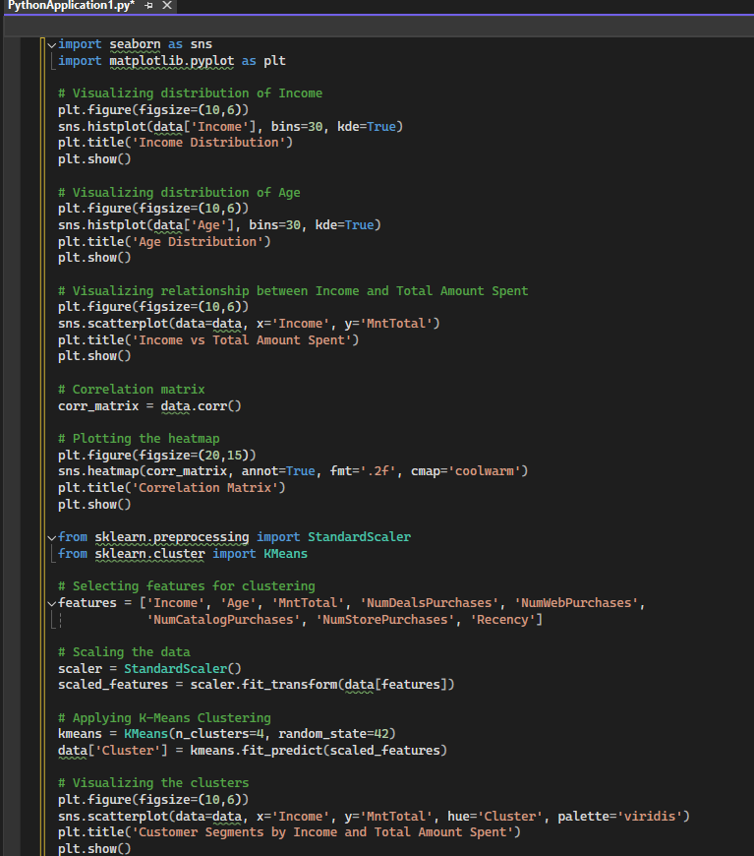
Customer Segmentation Using K-Means Clustering Applying K-Means clustering to segment customers based on their purchase behaviour and demographic information.

Slide 10

Insights and Recommendations
Segmentation of Customers
• High Income, High Spending Segment: Targets high-income customers with premium products and exclusive deals.
• Low Income, Moderate Spending Segment: Targets regular customers with discounts and budget-friendly options.
• Young, Low Spending Segment: Engages younger customers with trendy, affordable products and loyalty programs.
• Older, High Spending Segment: Provides personalized services and high-quality products to older customers.

Slide 11

Customer Segmentation Analysis Conclusion
• Identifies different consumer groups. • Influences focused marketing methods. • Improves consumer satisfaction. • Promotes business growth.

